Slide 1
CHAPTER 7
Polynomial and Rational Functions

Slide 2
Ch 7.1 Polynomial Functions ( Pg 565)
Linear functions f(x) = ax + b
Quadratic functions f(x) = ax² + bx+ c
Polynomial function of nth degree
f(x) = a_{n}x^{n} + a_{n-1} x^{n-1} + a_{n-2} x^{n-2} + …… + a ₂ x² + a₁ x + a₀
_{Where} a_{0 ,} a₁ a_{2 …… …..} an are constants . The coefficient of the
highest power term, the constant an Is called the lead coefficient

Slide 3
Special Products of Binomials ( Pg -567)
Difference of Two Squares
(a –b) (a + b) = a² - b²
(a + b) ² = a² + 2ab + b²
(a –b) ² = a² - 2ab + b²
Sum and Difference of Two Cubes
(a + b)(a² – ab + b²) = a³ + b³
(a –b)(a² + ab + b² ) = a³ – b³
Verify
( a + b) (a² – ab + b²) = a. a² – a . ab + a. b² + b. a² -b . ab + b. b²
= a³ - a² b + a b² + a² b - a b² + b³
= a³ + b³

Slide 4
Cube of a Binomial ( Pg – 571 )
(x + y) ³ = x³ + 3 x² y + 3x y² + y³
(x - y) ³ ⁼ x³ - 3 x² y + 3x y² - y³
Factoring the Sum or Difference of Two Cubes
x ³ + y ³ =(x + y)( x² - x y + y² )
x ³ - y ³ =(x - y)( x² + x y + y² )

Slide 5
Products of Polynomials ( pg 566)
Compute the products (x + 2) (5x³ - 3x² + 4)
= x(5x³ - 3x² + 4) + 2 (5x³ - 3x² + 4) ( Apply distributive property
= 5x⁴ - 3x³ + 4x + 10x³ - 6x² + 8 ( Combine like term)
= 5x⁴ + 7x³ - 6x² + 4x + 8
(x – 3)(x + 2)(x – 4)
= (x – 3)(x² - 2x – 8) (Apply distributive property )
= x(x² - 2x – 8)- 3(x² - 2x – 8)
= x³ - 2x² - 8x – 3x² + 6x+ 24 Combine like terms
= x³ - 5 x² - 2x + 24

Slide 6
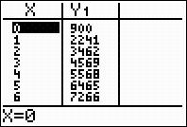
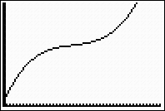
Ex 7.1, No 57, Page 575( only year change
The population P(t) of Cyberville has been
growing according to the formula
P(t) = t ³ - 63 t ² + 1403t + 900, where t is the number of
years since 1960
A) graph X min= 0 Y min= 0 X max = 47 Ymax = 20000
B) Population in 1960 900
1975 11,145
1994 15,078
C) Population from 1960 – 1961 1341
1975 – 1976 171
1994 – 1995 627
D) Least population in 1981
Graph

Slide 7
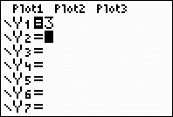
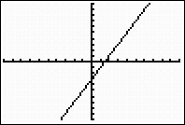
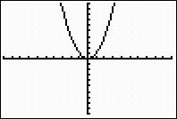
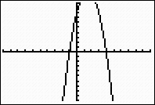
7.2 Graphing Polynomial Functions Classify the polynomials by degree (pg 577)
By graphing Calculator
f(x) = 3
f(x) = 2x – 3 f(x) = x ²
Turning point
f(x)= -2 x ² + 6x + 8

Slide 8
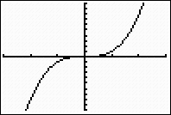
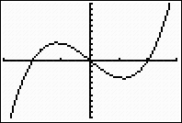
Find the zeros of each polynomial and list the x intercepts of its graph
Cubic Polynomials ( pg – 578)
x | P(x)
-3 | -15
-2 | 0
-1 | 3
0 | 0
2 | 0
3 | 15
y = x³ P(x) = x ³ - 4x
10
8
-3
3
3
-3
- 10
- 8
The y-values increase from - toward zero in the third quadrant, and
increase from zero toward + in the first quadrant, the graphs start at the
lower left and extend to the upper right
Both graphs are smooth curves without any break.
All cubic polynomials have positive Lead coefficients.
Odd degree

Slide 9
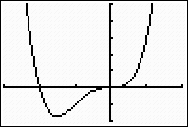
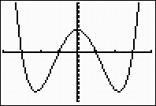
f(x) = x ⁴ + 2x ³
Quartric Polynomials
(pg 579)
x | f(x)
-4 | 105
-3 | 0
-2 | -15
- 1 | 0
0 | 9
1 2 3 4 | 0 -15 0 105
x | g(x)
-3 | 27
-2 | 0
-1 | -1
0 | 0
1 | 3
2 3 | 32 135
f(x) = x ⁴ - 10 x ² + 9
The y-values decrease from + and toward zero as x increases from - and the y-values increase toward + as x increases to +
Look like power function y = x⁴
The graph starts at the upper left end and extends to the upper right
Even degree

Slide 10
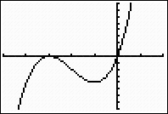
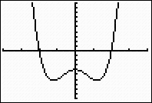
X intercepts and Factor Theorem 581
Factor Theorem - Let P(x) be a polynomial with real number
cooefficients. Then (x – a) is a factor of P(x) if and only if P(a) = 0
X-intercepts of Polynomials- A polynomial of degree n can have at most
n x-intercepts
Examples 3 (pg 581)
Find zeros of each polynomial, and list the x-intercepts of its graph
a). f(x) = x ³ + 6x ² + 9x = x(x ² + 6x + 9)= x(x + 3)(x + 3)
By factor theorem , the zeros are
x(x + 3)(x + 3) = 0
x = 0, x = - 3, x = -3
b). x ⁴ - 3x ² –4
= x ⁴ - 4x ² + x ² – 4
= (x ⁴ - 4x ²) + (x ² – 4) ( By grouping )
= x ² (x ² – 4) + (x ² – 4)
(x ² – 4)(x ² + 1)
= (x – 2)(x + 2) (x ² + 1) (Difference of two squares)
By factor theorem , zeros are
(x ² + 1) = 0
x = + =+ i
- -
And x = -2, 2

Slide 11
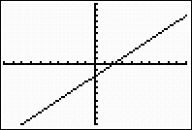
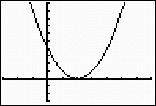
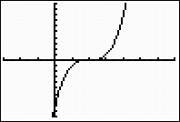
Zeros of Multiplicity Two or Three (pg – 582)
L(x) = x – 2 Q(x) = (x – 2) ² C (x) = (x – 2) ³
One Two Three
10
10
10
7
- 10
10
- 3
S shaped
-3
7
-10
Zero
- 3
- 10
Zeros
Zeros
First graph has a zero of multiplicity one at x = 2, and its graph crosses the x axis there
2nd graph has a zero of multiplicity two at x = 2, and its graph touches the x-axis there but changes direction without crossing
Third graph has a zero multiplicity three at x = 2.In this case, the graph makes an S shaped curve at the intercept, like the graph of y = x³

Slide 12
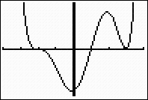
Five shaped curve Example 4 (Pg 583)
80
- 4
4
Graph the polynomial f(x) = (x + 2) ³ (x – 1)(x – 3) ²
Degree = 6 and even number. So its graph starts at the upper left and extends to the upper right
y-intercept is f(0) = (2) ³ (-1)(-3) ² = - 72
f has a zero of multiplicity three at x = - 2, a zero
multiplicity one at x = 1, and a zero of multiplicity two at x = 3 crosses the
x axis at x = 1, touches the x-axis and then changes direction at x = 3
- 80

Slide 13
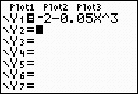
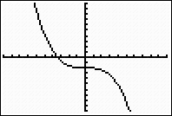
Ex 7.2
No.3
[ -10, 10, 1] by [ -10, 10, 1]
3 a. The graph g rises toward on the left and drops toward –
This long term behavior is the opposite as for the basic cubic because the lead
coefficient is negative
b) There is one x-intercept, no turning points, and one inflection point

Slide 14
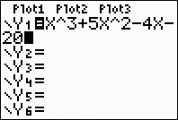
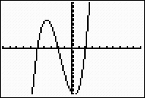
No. 7
[ -10, 10, 1] by [ -20, 20, 1]
a. The graph g rises toward - on the left and rises toward + on the right
This long term behavior is the same as for the basic cubic because the lead coefficient is positive

Slide 15
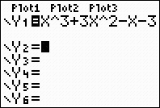
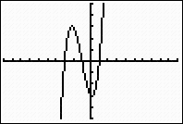
Ex 7.2
No 22. Sketch a rough graph of the polynomial function x³ – x +3x² – 3 to
know the shape of the curve
x intercepts ( -3, 0), (-1, 0), (1, 0)
B, C, Q(x) = (x+3)(x+1)(x-1)
= (x + 3) (x²-1)
= x³ – x +3x² – 3= x³ +3x² – x - 3
(Polynomial Functions)

Slide 16
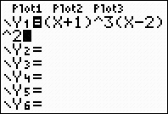
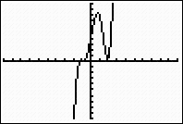
Sketch a rough graph of the polynomial function ( x + 1 ) ³ (x- 2)² to know the shape of the curve
No 34
Zeros
H(x) has zero at -1 and 2.The zero at -1 is of odd multiplicity (3) , so the graph will pass through the x-axis at this point. The zero at 2 is of even multiplicity(2), so the graph will touch, but not pass through, the x-axis at this point. Since the polynomial is of odd degree with positive lead coefficient, the gaph drops toward - on the left and rises toward
On the right. The y-intercept is at H(0) = 4
(y-intercept)

Slide 17
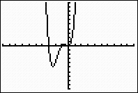
a) Find the zeros of each polynomial by factoring b) Sketch a rough graph by hand G(x) = x⁴ +4x³ + 3x²
Zeros
Zeros
a)G(x) = x²( x² +4x + 3)= x²(x + 3) (x + 1), so the zeros are 0, ( multiplicity2), -3(multiplicity1
and and -1(multiplicity 1)
b) As x = 0, the zero of even multiplicity, so the graph will touch the x-axis. The other two
zeros are odd multiplicity will pass through the x-axis at these points. Since the polynomial
is of even degree with positive lead coefficient, the graph rises toward + on the left
And rises on the right. The y-intercept is at g(0) = 0

Slide 18
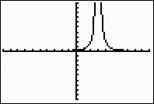
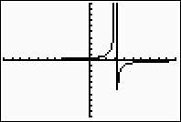
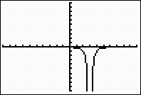
7.4 Rational Functions
A rational function is one of the form f(x) = where P(x) and Q(x) are polynomials. The graphs of rational functions can be quite different from the graphs of polynomials
Examples
2
-
2

Slide 19
Example 2 , Page 602
If Earth Care produces x T-shirts, their total costs will be 100 + 5x
dollars. To find the average cost per T-shirt, we divide the total cost
by the number of T-shirts produced, to get
C = g(x) = 100 + 5x
x
b) Evaluate the function for several values of x
The average cost of 5 T-shirt is
100 + 5(5) = 25
5
x | 1 | 2 | 4 | 5 | 10 | 20
c | 105 | 55 | 40 | 25 | 15 | 10
C
20
15
10
5
c) The graph
100 200 300 400
x

Slide 20
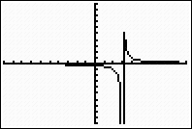
Vertical Asymptote pg 604
If Q(a) = 0 but P(a) = 0, then the graph of the rational function f(x) = has a vertical asymptote at x = a
-
-
2

Slide 21
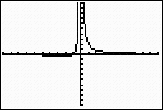
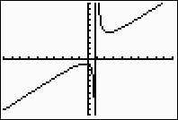
Horizontal Asymptote pg 606
Suppose f(x) = is a rational function, where the degree of P(x) is m and the degree of Q(x) is n
If m < n , the graph f has a horizontal asymptote at y = 0
If m = n, the graph of f has a horizontal asymptote at
y = where a is the lead co-efficient of P(x) and b is the lead coefficient of Q(x)
If m > n, the graph of f does not have a horizontal asymptote

Slide 22
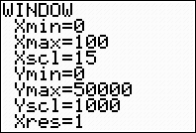
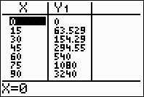
Ex 7.4, No 3, Pg 611
C(p) =
a) Domain of C = 0< p < 100
b) The table
c) 60%
d) p < 80%
0 | 15 | 25 | 40 | 50 | 75 | 80 | 90 | 100
0 | 63.5 | 120 | 240 | 360 | 1080 | 1440 | 3240 | -

Slide 23
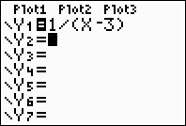
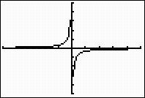
No.14a)Sketch the horizontal and vertical asymptotes for each function b) Use the asymptotes to help sketch the rest of the graph vertical asymptote
Horizontal asymptote
x – 3 equals zero for x = 3, so that is the vertical asymptote. The degree of the
Denominator exceeds that of the numerator, so y= 0 is the horizontal asymptote. To
complete the sketch , plot a few points on either side of the vertical asymptote. For
example, when x =2, y = -1. so (2, -1) is a point on the graph. The y-intercept is (0, -1/3)

Slide 24
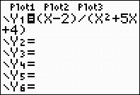
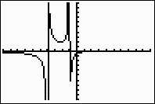
No. 23
x² + 5x + 4 = (x +4)(x+1) vertical asymptotes
horizontal asymptote
So the vertical asymptotes are x = -4 and x = -1. The degree of the denominator exceeds that of the numerator, so y = 0 is the horizontal asymptote. The numerator is zero for x = 2, so (2,0) is the x intercept. The y-intercept is (0, -1/2) . Plot additional points, such as (-2, 2) and (-5, -7/4).

